Slide 1
User Generated Content and Product Preference Networks
MSBA, 3rd October, 2023

Slide 2
Predicting Business Outcomes From User Generated Content
Can UGC (e.g., product reviews) predict business outcomes such as sales and market share?
Often users mention competing products in reviews
Can we extract preference information?
Can we draw product preference networks?
Can such networks help predict business outcomes?
Slides based on Zhang et al. (2013) – not shared because of errors in the article

Slide 3
From Product Comparisons to Preference Networks
“The B&W P7 are highest on my favorite list after the H8 by B&O. I also like the new P5 because their sound is almost as good as the P7.”
“Love the luxury, style and performance of the A6; the Lexus GS300 is a nice reliable car and a very good value, but lacks the coolness factor.”
Sentiment score
= +4
Weight = 4-2 = 2
+2
+3
4-3 = 1
Audi A6
+4
Lexus GS300
“I need a reliable car with the great creature comforts, and while the A6 is wonderful, it’s quite expensive; the Lexus GS300 isn’t exactly the lap of luxury, but fits the bill in every way.”

Slide 4
A Product Preference Network

Slide 5
The Main Idea
Create a product preference network from conversations
Arrows indicate implicit preferences
Relative desirability of a node
A product review
Must mention two or more products
Has two sentiment scores (s₁ and s₂) for two products 1 and 2, respectively.
Arrow between the two product, tip ends on the product with higher sentiment score
Difference in sentiment scores becomes the weight of the arrow
How to put a score on each node which represents its desirability

Slide 6
What Metric Can Capture the Relative Importance of a Product?
Create a network of product preferences
PageRank is one possibility
Developed by Larry Page, Serge Brin & Rajiv Motwani at Stanford
A variation of the good old eigenvector algebra
Based on how many web pages refer to a particular web page.

Slide 7
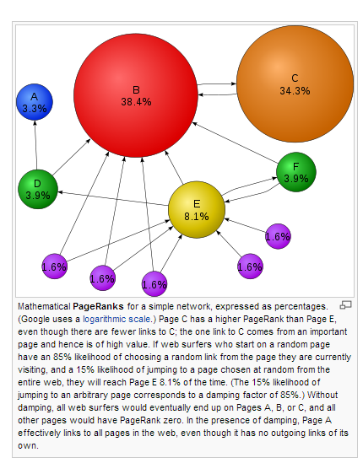
PageRank to the Rescue
If many web pages refer to a page, the latter must be important
If the referring pages are referred to by many other pages, the effect is stronger
Source: Wikipedia

Slide 8
Weighted PageRank
Not all incoming links are created equal
Different ways to create weights on links
networkx library in python can calculate weighted PageRank scores

Slide 9
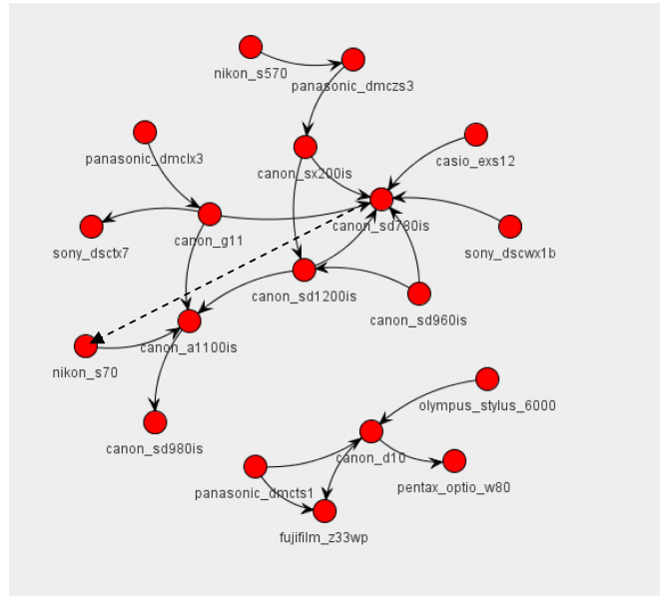
Real World Implications

